Slide 1

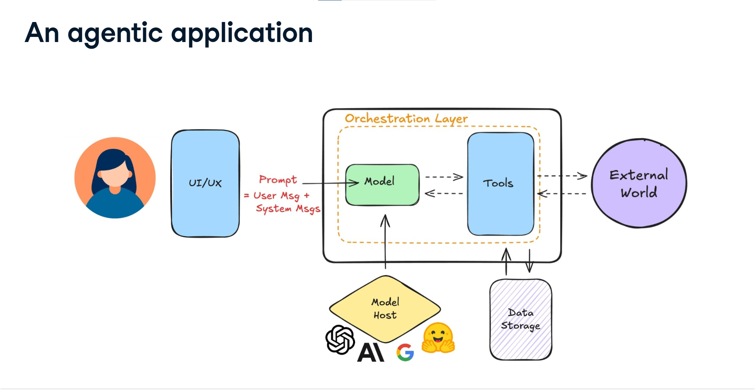
Introduction to Agentic AI Personal Assistants
An
agentic AI personal assistant
is a next-generation AI
system that:
Understands natural language commands
Breaks down complex tasks into actionable steps
Executes tasks across various applications autonomously
Maintains context and learns from interactions
Proactively assists users based on patterns and preferences
Unlike traditional assistants
(Siri, Alexa) that primarily respond to
specific commands, our agentic assistant:
Has agency to plan and execute multi-step tasks
Integrates with a wide range of tools and services
Adapts to user preferences and behavior over time
Operates within a secure, sandboxed environment
1

Slide 2

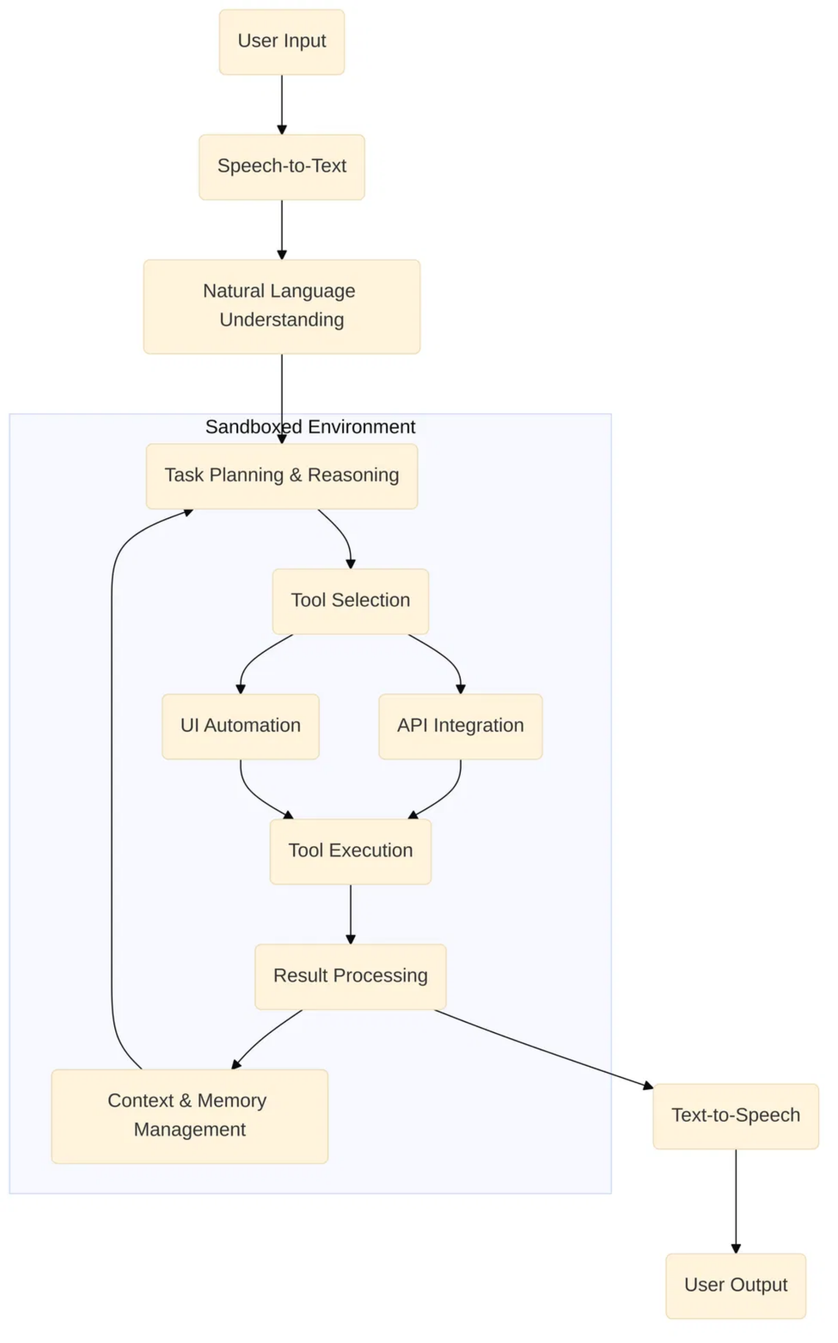
Core AI Components
Speech-to-Text (STT)
Natural Language Understanding
Converts spoken language into text
Interprets text and determines intent
Task Planning
Tool Execution
Breaks requests into actionable steps
Interfaces with external systems
Text-to-Speech
Context & Memory
Converts text to natural speech
Maintains history and preferences
2

Slide 3
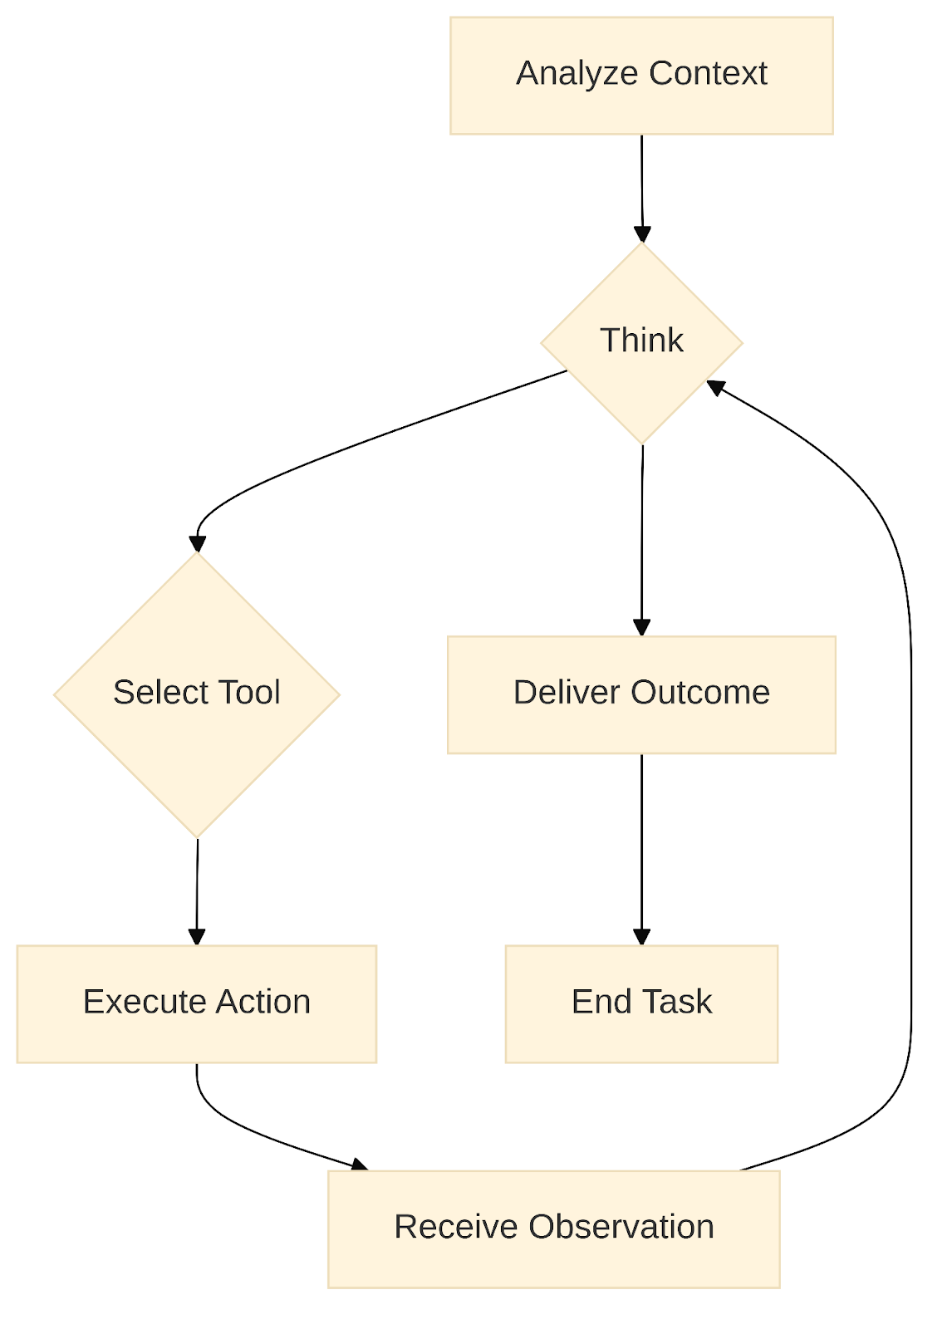
The Agent Loop: How It Works
Our agentic AI personal assistant operates through an iterative "agent loop" that enables it to understand, plan, and execute complex tasks:
1
Analyze Context
Understand the user's intent and current state based on the request and previous interactions.
2
Think & Plan
Reason about the task, update plans, and determine the next action to take.
3
Select & Execute Tools
Choose appropriate tools from the available toolkit and execute them within the sandboxed environment.
4
Observe & Iterate
Process the results of tool execution, incorporate new information, and continue the loop until task completion.
5
Deliver Outcome
Present results to the user and maintain context for future interactions.
3

Slide 4



Tool Integration Approaches
Our agentic AI personal assistant integrates with external tools and services through three main approaches:
API-Based Integration
Direct programmatic access to services via structured APIs
Reliable, efficient, secure
Limited by API availability
UI Automation
Simulates human interactions with graphical interfaces
Works with any application with a GUI
Fragile to UI changes, slower
MCP Integration
Direct programmatic access to services via structured APIs
Reliable, efficient, secure
Limited by API availability
Hybrid Approach (Our Solution)
Combines API and UI automation for maximum coverage
Optimal flexibility and resilience
Increased complexity
4

Slide 5
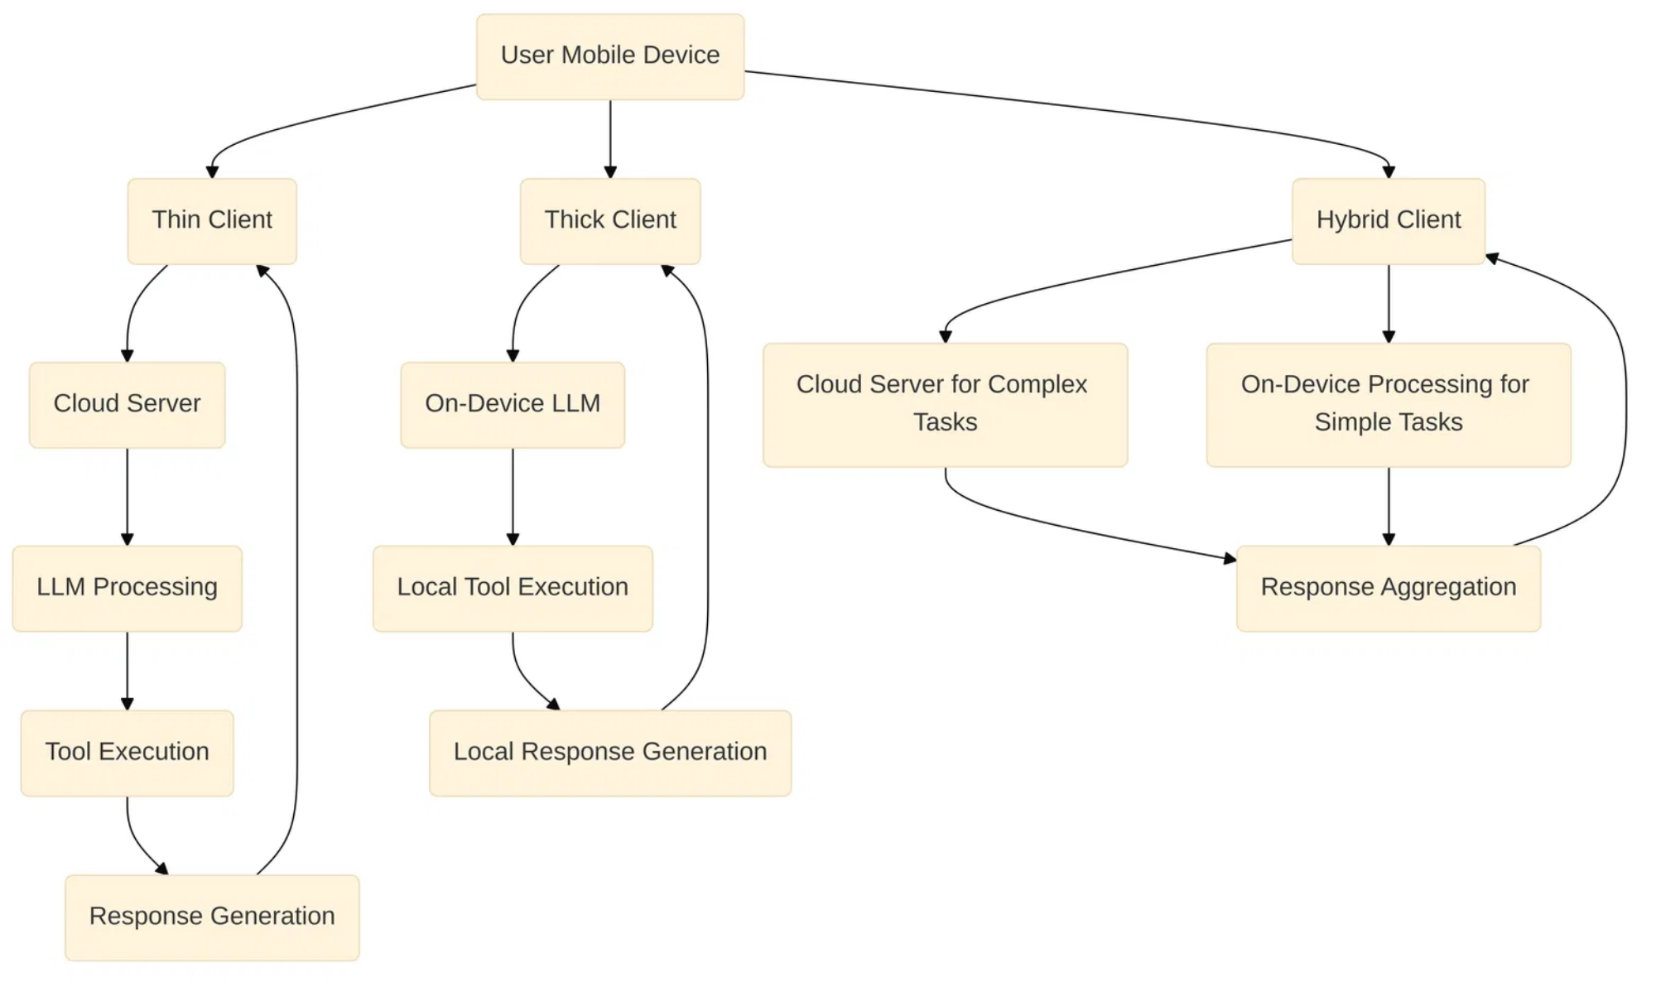

Mobile App Integration Architecture
Integrating our agentic AI into a mobile application requires careful architectural decisions to balance performance, privacy, and user experience:
Thin Client (Cloud-Based)
Mobile app acts as UI, with core AI logic on remote servers
Access to powerful models, easy updates
Latency, offline limitations
Thick Client (On-Device)
AI logic runs directly on the mobile device
Low latency, enhanced privacy
Resource constraints, larger app size
Hybrid Client (Our Approach)
Balances processing between device and cloud
Optimal performance, flexibility
Increased architectural complexity
5

Slide 6
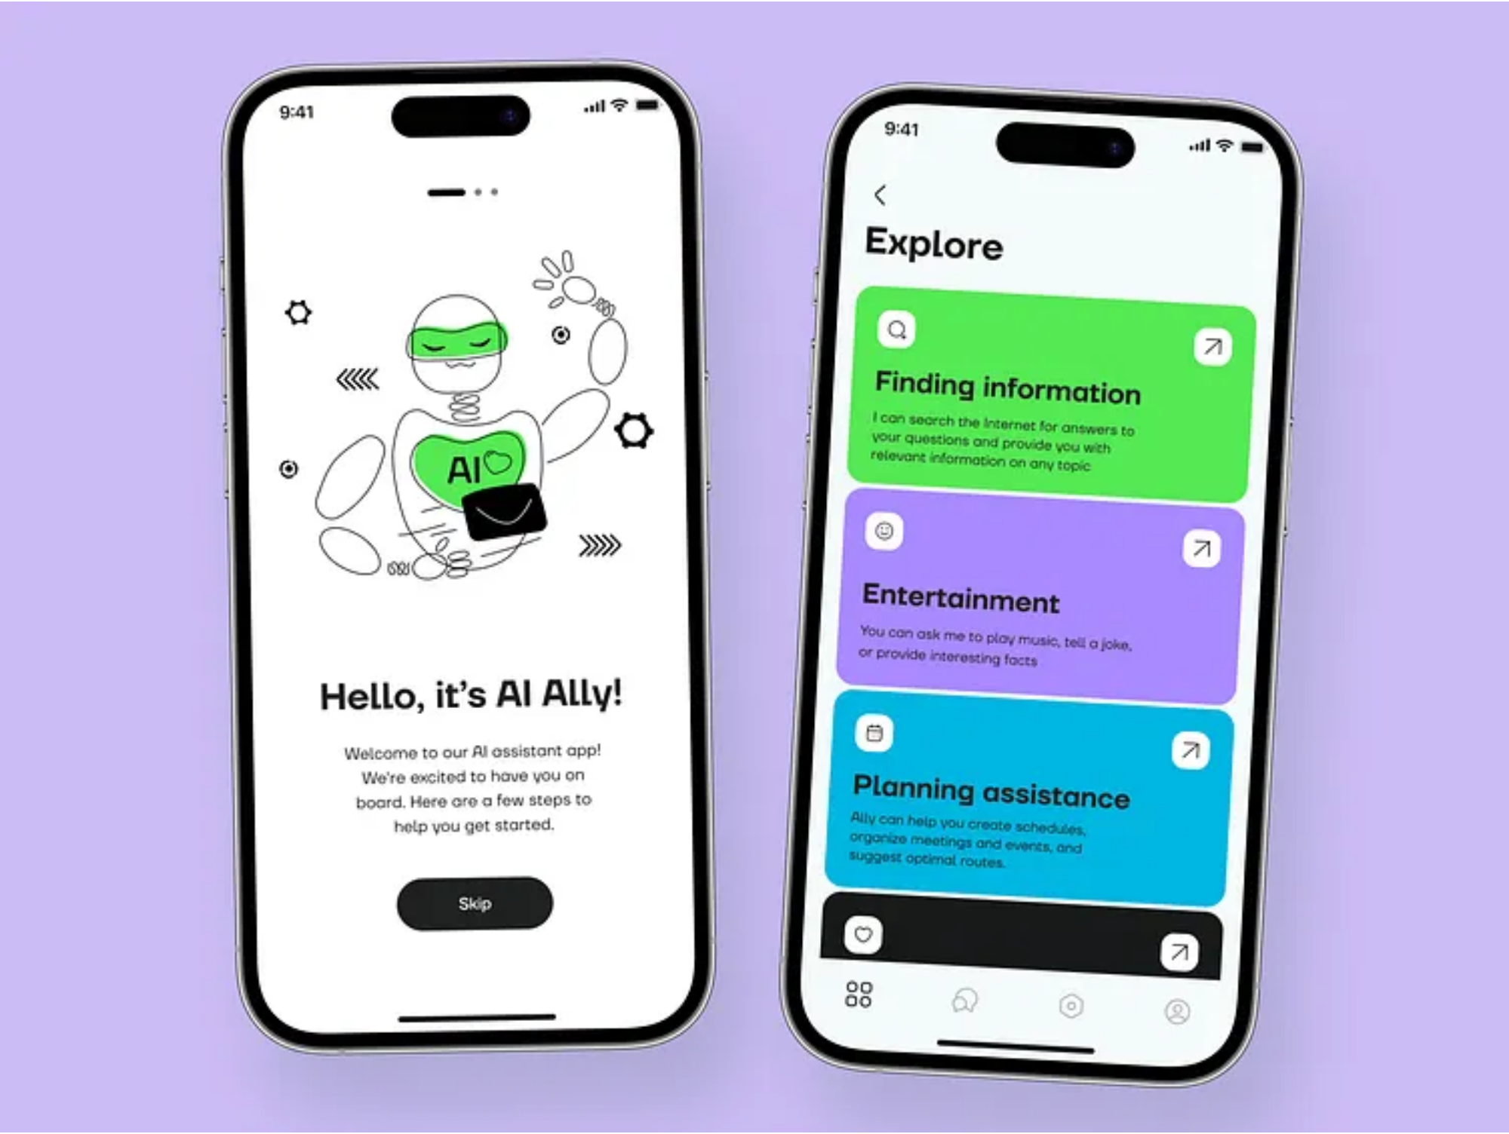




User Experience & Interface Design
Our mobile AI assistant is designed with these key UX principles:
Voice-First Interaction
Prominent microphone button, clear visual feedback during listening, and intuitive ways to interrupt or correct the AI.
Visual Feedback for Actions
Progress indicators, status messages, and animations that reassure users when the assistant is working on tasks.
Contextual Information Display
Presenting information (summaries, calendar entries, etc.) in visually organized, easily readable formats.
Accessibility & Transparency
Support for screen readers, clear contrast, customizable text sizes, and transparent permission management.
USER DASHBOARD
PRESENT SUMMERIES FOR USER LIFE STATS.
6

Slide 7
Tools
Lang chain / lang graph
FastApIs
React Native/swift/kotlin
LLMs
ui automation frameworks
6

Slide 8
Research Papers
https://dl.acm.org/doi/pdf/10.1145/3701716.3717526
https://www.ijfmr.com/papers/2024/6/30587.pdf
https://docs.google.com/document/d/1ZNkWWtxbpc3uKEaw0kXe1EsEHNV6KavYRQk7lzeh_0c/edit?tab=t.0

